Slide 1
Welcome!

Slide 2

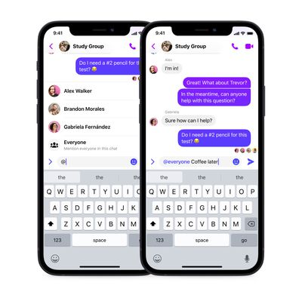
What is this course all about?
If you’ve ever wondered
how Google is able to answer all your questions
how cars can drive themselves
how an app or video game works
this is where to start!

Slide 3
What is this course all about?
If you’ve ever wondered
how Google is able to answer all your questions
how cars can drive themselves
how an app or video game works
this is where to start!
Programming enables all these things!

Slide 4
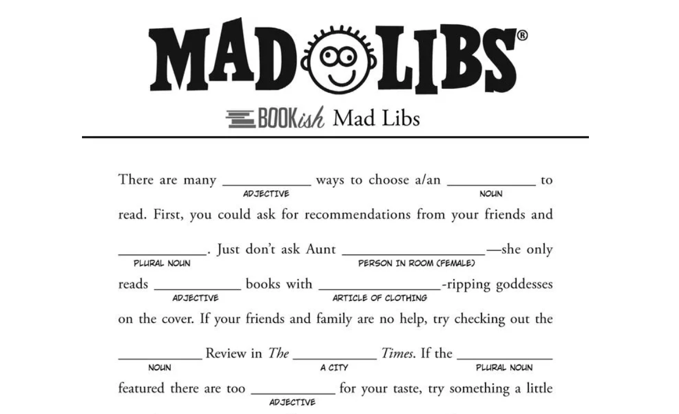
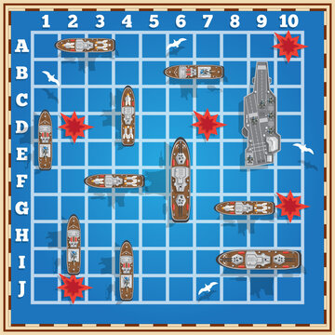
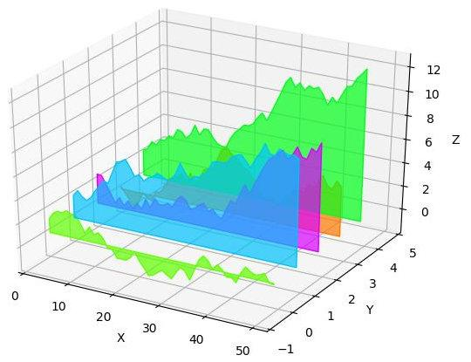

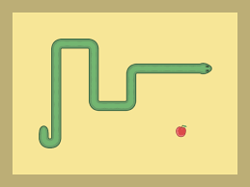
What will we do in this course?
Learn how to make customizable Mad Libs!
Program games of Go Fish, Battleship, and Space Invaders!
Make fancy plots of data!
Complete a final project of your choice!
Make your own version of Pong, Snake, Checkers, or a choose-your-own-adventure game!

Slide 5
Programming is about providing specific instructions
Computers execute instructions exactly as they are given.
How would you give instructions for making a PB&J sandwich?

Slide 6
How do we give specific instructions?
You often give instructions in the order you want someone to do something.
Q: How do I find the bagel shop?
A: Go to the end of the block, then turn left.
Saying, “Turn left, then go to the end of block” would likely get someone lost!

Slide 7
How do we give specific instructions?
You might give instructions that depend on the different situations that might arise, i.e. they are conditional.
Let’s imagine you order a latte at a coffee shop, but need to leave in 10 minutes. You might tell the barista:
“If my drink is finished in 5 minutes, put it in a mug so I can enjoy it here. If it takes longer than 5 minutes, please put it in a to-go cup.”
With these instructions, the barista will take different actions based on how long the coffee takes to prepare.

Slide 8
How do we give specific instructions?
You might need to tell someone what to keep track of as they follow the instructions.
In the previous example, you are implicitly asking the barista to keep track of the time it takes to prepare your drink.
The barista needs to note the time as they begin to prepare your drink and calculate the elapsed time when your drink is finished before acting on that information.

Slide 9
How do we give specific instructions?
You might need to tell someone when they are finished.
When following some sets of instructions, it is obvious when you are finished, but when following others it might be less obvious.
If you were providing someone directions to a gas station, you might say:
“Drive down this road until you see a green sign on your left.”
The sign is the driver’s cue to stop!

Slide 10
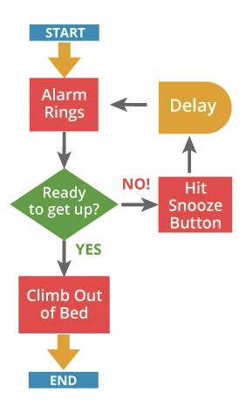
Flowcharts
Flowcharts are a diagrammatic way of conveying instructions that emphasize:
The order of things to do.
What to do in different situations that might arise.
What to keep track of as the task is done.
When to stop.

Slide 11
Flowcharts
Arrows indicate the order of things to do!

Slide 12
Flowcharts
Arrows indicate the order of things to do!
Red squares are actions.

Slide 13
Flowcharts
Arrows indicate the order of things to do!
Red squares are actions.
Green diamond indicates a decision!

Slide 14
Flowcharts
Arrows indicate the order of things to do!
Red squares are actions.
The alarm clock has to keep track of time here!
Green diamond indicates a decision!

Slide 15
Flowcharts
Arrows indicate the order of things to do!
Red squares are actions.
The alarm clock has to keep track of time here!
Green diamond indicates a decision!
This tells us we are finished!

Slide 16
“Program” your partner to draw a spider
(using a flowchart)
You might need to tell your partner to keep track of how many legs they have drawn and which side of the body to draw new legs on!
If you are the partner following the flowchart, don’t use your common sense!

